Slide 1
VA Healthcare
Jessica King, 53927
DSO Dept. Of PA

Slide 2
Leadership
Bill Roland- Commander
Jim Brown- Sr. Vice Commander
Glenn Owens- Jr. Vice Commander
John B. Getz, Jr.-State Adjutant/Quartermaster
Phone: 717-234-7927 Email: quartermaster@vfwpahq.org
Jessica King- Department Service Officer
Cell: 724-672-2953 Email: Jessica.king9@va.gov

Slide 3
Contact Us
List of accredited staff in the Department
Department Service Officer- Jessica King
Accreditation Number 53927
Phone: 724-672-2953
Email:Jessica.king9@va.gov
The Link for all PA Staff - UpdatedServiceOfficers.pdf

Slide 4
What is a PBA
What is a Post Benefit Advisor (PBA)?
PBA are local ambassadors of the VFW, whose primary objective is connecting veterans and their families to the appropriate veteran resource. A PBA is like a sponsor for military families when they PCS.
What does a PBA do?
PBAs provide a much-needed resource at the local Post by offering advice to veterans and their families on available benefits and services. They also assist in getting them in touch with an accredited representative to pursue their Federal benefits. PBAs need to be well versed on benefits available in the local community as well as generally knowledgeable about the VA claims process.

Slide 5
PBA’s and Where to Go
PBAs must know where to direct veterans for assistance with:
• VA benefits
• VFW benefits
Local veteran events
Local and state benefits such as property tax relief
Local Discounts
Employment Resources
• Emergency financial help
• Homeless shelters
Any other local benefits that may make life easier for a veteran and their family

Slide 6
Difference between a PBA and an Accredited Rep
Action | PBA | Accredited Rep
Provide general advice/guidance concerning VA benefits | X | X
Provide advice and assistance with obtaining state or local benefits | X | X
Help the veteran/claimant complete forms |  | X
Sign VA Form 21-22 |  | X
Represent Claimants at VA hearings |  | X
Request status from VA and speak to VA on the veteran’s behalf |  | X
Accept/Submit PII and VA Forms |  | X
Sign forms on behalf of Claimant |  | X

Slide 7
Types of Discharges
Discharge | Overview
Honorable | All veteran and military benefits
General Discharge Under Honorable Conditions | Most veteran and military benefits except for GI Bill
Other Than Honorable Conditions Discharge (OTH) | VA will determine if eligible for any benefits
Bad Conduct Discharge (BCD) | VA will determine if eligible for any benefits
Dishonorable Discharge | No veteran or military benefits except mental health treatment
Officer Dismissal | Commissioned officers may receive a dismissal notice which is the same as a dishonorable discharge
Uncharacterized/Entry Level Separation (ELS) | No benefits earned unless they were injured or incurred an illness as a result of service

Slide 8
Characters of Discharge
VA benefits are based on the veteran’s service and their type of discharge.
VFW representation is open to all veterans except those with a Dishonorable discharge.
VA administrative decisions are used to determine eligibility to benefits if the veteran does not have an honorable discharge
Veterans with an undesirable discharge may seek a discharge upgrade through their branch of service, however, the VFW cannot assist with the discharge upgrade process

Slide 9
Healthcare
VA provides a number of Health Care Services
Hospital, outpatient medical, dental, pharmacy and prosthetic services
Domiciliary, nursing home and community based residential care
The Mission Act gives Veterans greater access to health care in VA facilities and the community, expands benefits for caregivers, and improves VA’s ability to recruit and retain the best medical providers.
Community Care - Based on access standards for average
30 minute drive/20 day wait time for primary care, mental health and non-institutional care services
60 minute drive/28 day wait time for specialty care

Slide 10
VA Healthcare System
The VA operates one of the largest integrated healthcare systems in the world, providing comprehensive medical services to eligible veterans through VA Medical Centers (VAMCs) and other outpatient clinics.
The VA's healthcare system is designed to meet the unique needs of veterans, offering a wide range of the following medical services including:
Medical Care including preventive care, mental health, telehealth and rehabilitation
Prescription Medication Coverage

Slide 11
Who is Eligible?
If you enlisted after September 7, 1980, or entered active duty after October 16, 1981
You must have served 24 continuous months or the full period for which you were called to active duty, unless any of the descriptions below are true for you.
This minimum duty requirement may not apply if any of these are true:
You were discharged for a disability that was caused—or made worse—by your active-duty service, or
You were discharged for a hardship or “early out,” or
You served prior to September 7, 1980

Slide 12
Reserve/Guard
Call to active duty by a federal order and completed the full period for which you were called or ordered to active duty.
Training DOESN’T count

Slide 13
Toxic Exposure Home or Aboard
You must meet the basic requirements
  24 continuous months expect for Vietnam
  Honorable Discharge
  You were exposed to toxins or other hazards while serving our country—at home or abroad.
      Toxins/Hazards
        Chemicals
        Pesticides
        Lead
        Asbestos
        Certain Paints
        Nuclear weapons
        X-Rays

Slide 14
Other Ways to be eligible…
You receive financial compensation (payments) from VA for a service-connected disability.
You were discharged for a disability resulting from something that happened to you in the line of duty.
You were discharged for a disability that got worse in the line of duty.
You’re a combat Veteran discharged or released on or after September 11, 2001.
You get a VA pension.
You’re a former prisoner of war (POW).

Slide 15
Other Ways to be eligible…
You have received a Purple Heart.
You have received a Medal of Honor.
You get (or qualify for) Medicaid benefits.
You served in Southwest Asia during the Gulf War between August 2, 1990, and November 11, 1998.
You served at least 30 days at Camp Lejeune between August 1, 1953, and December 31, 1987.

Slide 16
Other Ways to be eligible…
Vietnam War era:
Any U.S. or Royal Thai military base in Thailand from January 9, 1962, through June 30, 1976
Laos from December 1, 1965, through September 30, 1969
Cambodia at Mimot or Krek, Kampong Cham Province from April 16, 1969, through April 30, 1969
Guam or American Samoa or in the territorial waters off Guam or American Samoa from January 9, 1962, through July 31, 1980
Johnston Atoll or on a ship that called at Johnston Atoll from January 1, 1972, through September 30, 1977
Republic of Vietnam from January 9, 1962 through May 7, 1975

Slide 17
Other Ways to be eligible…
Or based on your income.

Slide 18
What does that mean??
All VFW Members could/should be eligible for VA healthcare….

Slide 19
Not be eligible?
Discharge
  Must have an honorable
Income
  Make too much
Not enough time in service
Guard/Reservist

Slide 20
Ways to help counter
Discharge
  Veterans can file for discharge upgrade
    Through a VSO
Income
  Service Connection
  Lost of Job/High Medical Cost
Guard/Reserve
  Service Connection

Slide 21

VA Healthcare Priority Groups
VA assigns priority groups to veterans based on various factors, including service-connected disabilities, income, and other considerations. The quality of care is not affected by priority group; rather these groups help VA determine potential co-payments.

Slide 22
VA Healthcare Priory Groups
Priority Group 1: Service Connected at 50% or greater, determined to be unemployable due to service connection, Medal of Honor recipients
Priority Group 2: Service Connected at 30% - 40% overall
Priority Group 3: Service Connected 10% - 20%, POWs, Purple Heart Medal recipients, veterans with a 1151 claim granted and VR&E program participants
Priority Group 4: Those receiving Aid and Attendance or Housebound, Catastrophically Disabled

Slide 23
VA Healthcare Priority Groups
Priority Group 5: Service Connected 0% (income based), receiving VA Pension, Medicaid eligible
Priority Group 6: Service Connected 0% Military exposures (i.e., herbicide, Camp Lejeune), Combat Operations (5 year enhanced benefits)
Priority Group 7: Not Service Connected (household income below geo-adjusted VA threshold income limits)
Priority Group 8: Not Service Connected / Non-compensable 0% with household income exceeding geo-adjusted VA income limits

Slide 24
Issues?
If a Veteran comes to you and says they had a problem a VA…..
  VA Advocate
  VSO
  VFW Healthcare Policy Team

Slide 25
The VA Patient Advocate
VA Patient Advocates serve as a liaison between veterans and the VA healthcare system, aiming to ensure that veterans receive high-quality care and have a positive experience within the VA healthcare system. The Patient Advocate plays a crucial role in addressing veterans' concerns, resolving issues, and advocating for their rights.
Patient Advocates work to represent the interests and concerns of veterans within the VA healthcare system. They strive to ensure that veterans receive timely and appropriate care and have their needs addressed. Ask for the Patient Advocate at the local VA Medical Center in person or via phone.

Slide 26
Caregivers, PCAFC & PGCSS
The Program of Comprehensive Assistance for Family Caregivers (PCAFC) provides support to eligible veterans who have serious injuries and need the assistance of a caregiver for daily living activities. The program is designed to recognize and support the vital role that family caregivers play in the care and rehabilitation of veterans.
The Program of General Caregiver Support Services (PGCSS) provides peer support mentoring, skills training, coaching, telephone support, online programs, and referrals to available resources to caregivers of Veterans. The Veteran must be enrolled in Veterans Affairs (VA) health care and be receiving care from a caregiver in order for the caregiver to participate

Slide 27
Caregivers- Eligibility for Veterans
Eligibility requirements for the veteran: In order for a veteran to be eligible for a caregiver ALL the following must be true:
The Veteran has a VA disability rating (individual or combined) of 70% or higher
The Veteran was discharged from the U.S. military or has a date of medical discharge
The Veteran needs at least 6 months of continuous, in-person personal care services

Slide 28
Caregivers- Eligibility for Caregivers
Eligibility requirements for the caregiver: In order to be eligible to be a caregiver the applicant must be 18 years old and at least 1 of these is true:
A spouse, son, daughter, parent, stepfamily member, or extended family member of the Veteran
Applicant lives full time with the Veteran, or they’re willing to live full time with the Veteran if designated as a family caregiver
Find VA Locations | Veterans Affairs

Slide 29
Caregiver
Eligibility requirements for the caregiver: In order to be eligible to be a caregiver the applicant must be 18 years old and at least 1 of these is true:
A spouse, son, daughter, parent, stepfamily member, or extended family member of the Veteran
Applicant lives full time with the Veteran, or they’re willing to live full time with the Veteran if designated as a family caregiver

Slide 30
How can you help as PBA?
Give them the application – 1010ez form
  You can help them with it. They must sign it. Mail it.
Refer them to closest VA to get enrolled
  DD214
  Income
    Spouses' information as well
Refer them to Service Officer

Slide 31
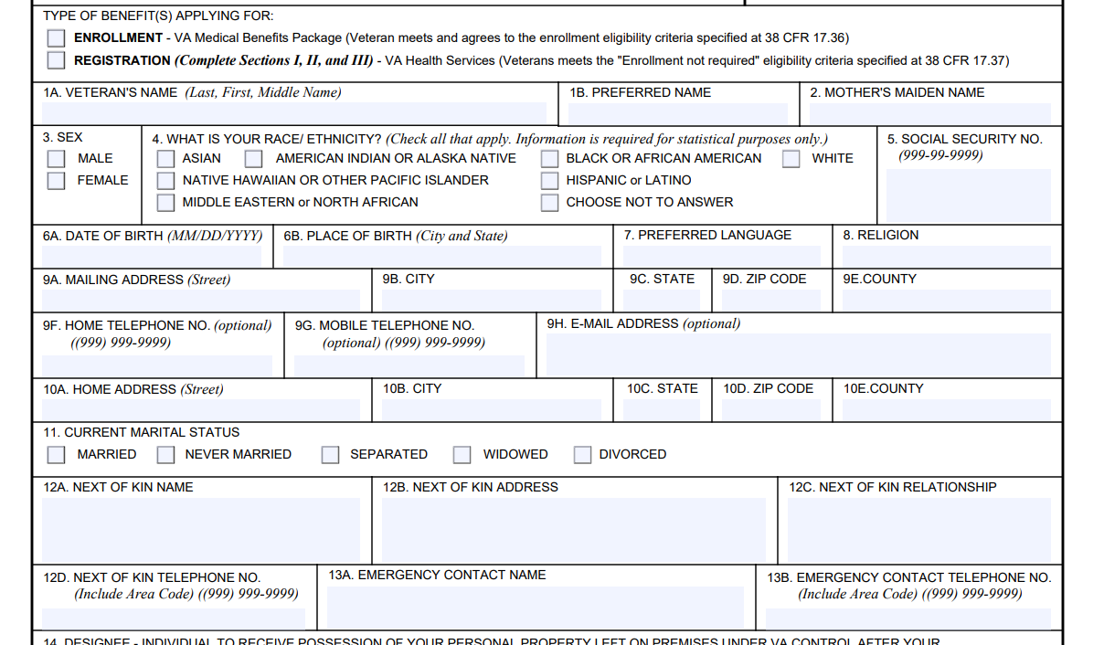
1010ez

Slide 32
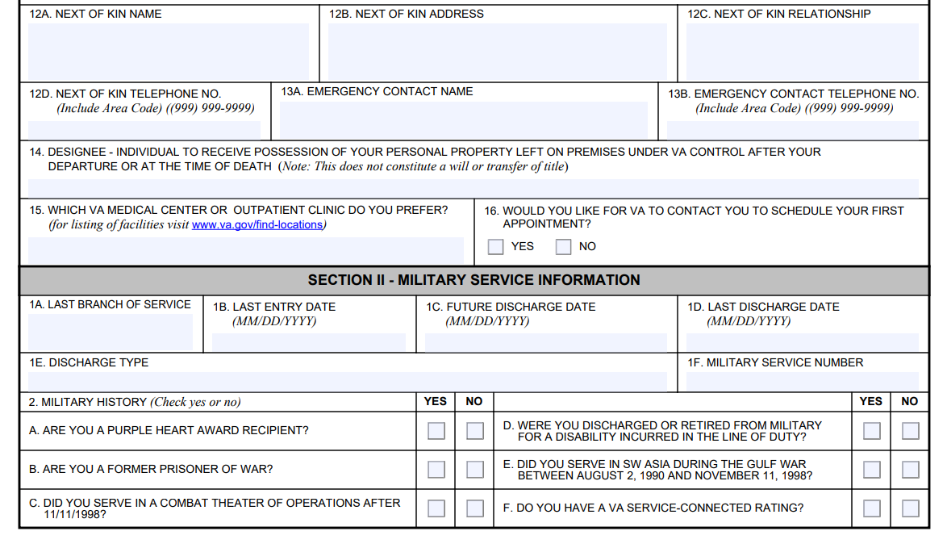

Slide 33
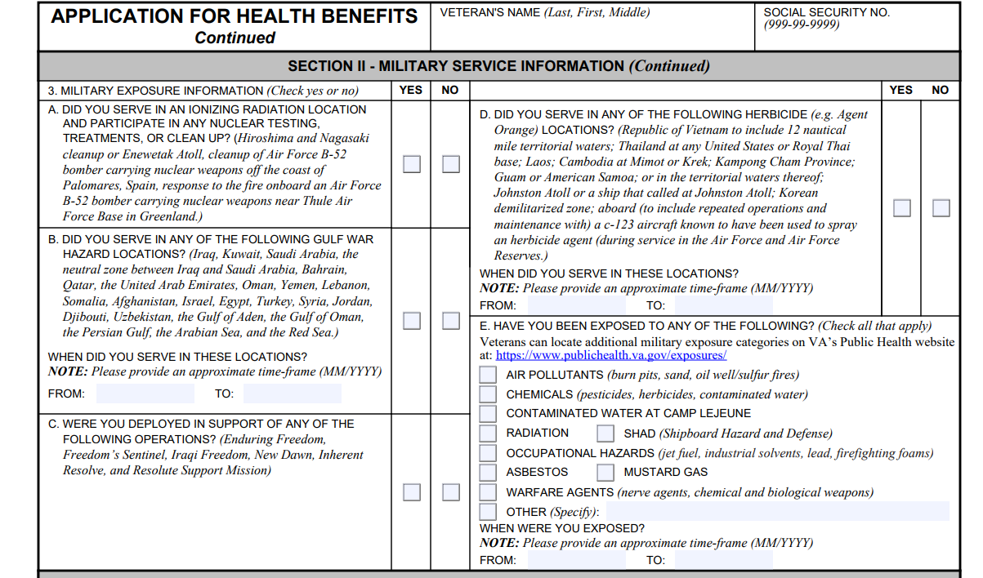

Slide 34
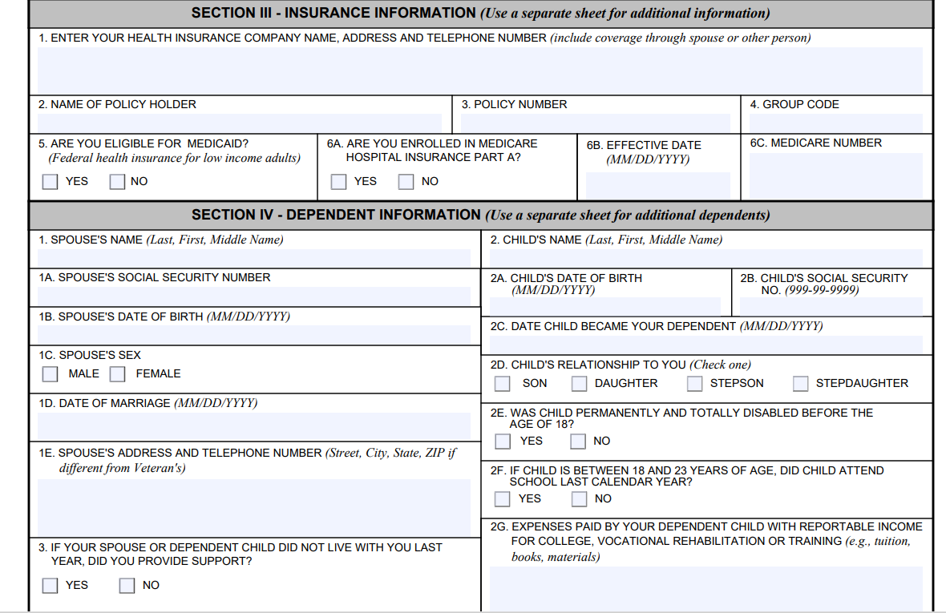

Slide 36
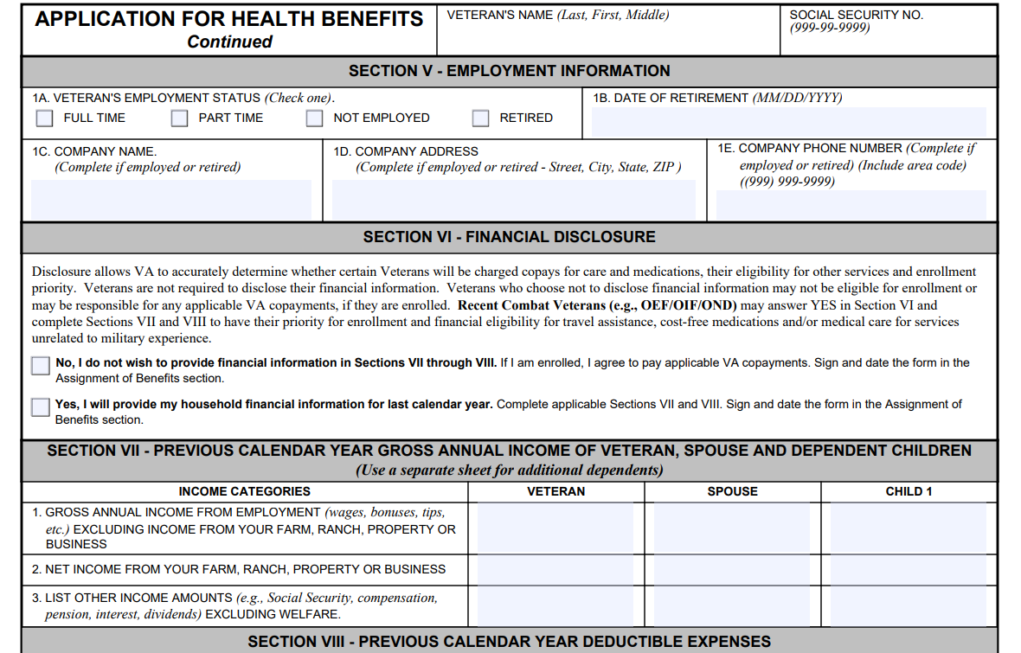

Slide 37
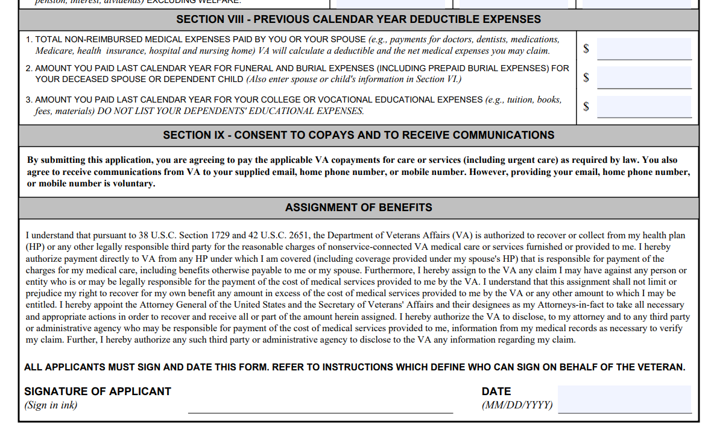

Slide 38
Don’t KEEP this form or DD214
They must send it or take to VA closest to them.

Slide 39
Cont.
Have them call 877-222-8387.

Slide 40
Mental Health

Slide 41
Mental Health
Call #988 press 1
  Anyone call
Walk into a VA Hospital- Anytime of the day
To talk with a peer coach, call Military OneSource’s free, confidential peer support services at 800-342-9647. This service is available 24 hours a day, 365 days a year.

Slide 42
Mental Health
As a PBA, if someone is having a mental health crisis always call 911 or the crisis line #988 #2.
  Anyone can call for a Veteran.
All Veterans can do walk-in at the VA health care center.

Slide 43
What are Vet Centers?
Vet Centers are community-based counseling centers that provide a wide range of social and psychological services, including professional counseling to eligible Veterans, service members, including National Guard and Reserve components, and their families. Counseling is offered to make a successful transition from military to civilian life or after a traumatic event experienced in the military to include military sexual trauma (MST). Individual, group, marriage and family counseling is offered in addition to referral and connection to other VA or community benefits and services. Vet Center counselors and outreach staff, many of whom are Veterans themselves, are experienced and prepared to discuss the tragedies of war, loss, grief and transition after trauma.

Slide 44
Vet Centers
Individual and group counseling
Couples and family counseling
Military sexual trauma (MST) counseling
Readjustment counseling, like mental health services, and educational and
employment counseling
Bereavement (grief) counseling
Substance use assessment and referral

Slide 45
Vet Center Eligibility
Service in Combat or received immediate danger pay (VFW Eligible)
Anyone that experienced MST
Service members currently serving
Family Members (18 and older)

Slide 46
Vet Centers
To find a Vet Center near you call
1-877-927-8387

Slide 47
Compensation

Slide 48
Compensation Benefits
VA Compensation: A monthly tax-free payment made to veterans for service-connected disabilities that are rated at 10% or more. It is based on the severity of the veteran’s service-connected conditions and is assigned in increments of 10%. (there is no 95%)
VA compensation rates can be found by visiting: https://www.va.gov/disability/compensation-rates/veteran-rates/
Veterans receiving compensation may be eligible for other VA or local benefits based on their rating percentage.
* A service-connected condition is one that is recognized by the VA as being caused by active-duty service*

Slide 49
Compensation Overall benefits
Free VA healthcare is provided for ALL service-connected disabilities
10% overall rating: VA provides hearing and vision aids regardless of what the veteran is service connected for and VA waives the funding fee for VA Home Loan
30% overall rating: Veterans can add their dependents to their compensation award increasing their overall amount of compensation

Slide 50
Compensation Overall benefits
50% overall rating: Veteran is placed in VHA Priority Group 1 allowing for treatment for any conditions regardless of service connection. If retired from the military, the veteran can receive both VA and Military Retirement pay simultaneously
70% overall rating: If unable to work due to their service connected conditions, the veteran may be eligible for Individual Unemployability (IU)
100% Permanent and Total (P&T): Veteran’s dependents are eligible for Dependent Education Allowance and Healthcare.
* Not a complete list of all overall VA rating percentages *

Slide 51
Homelessness

Slide 52
Homelessness
HUDVASH
HUD-VASH is a collaborative program that pairs HUD’s Housing Choice Voucher (HCV) rental assistance with VA case management and supportive services. These services are designed to help homeless Veterans and their families obtain permanent housing and access the health care, mental health treatment, and other supports necessary to help them improve their quality of life and maintain housing over time.

Slide 53
“We are the gateway for veterans—connecting them to trusted resources, proven organizations, and the benefits they deserve. When veterans turn to us, they’re met with guidance they can rely on and support they can trust.”
No one Does More for Veterans than the VFW

Slide 54
Homelessness
1-877-4AID VET (877-424-3838)

Slide 55
VFW Programs VAVS
VA Volunteer Services (VAVS)
VAVS is a program that coordinates volunteer efforts to provide assistance and support to veterans receiving care at VA medical facilities across the United States. VAVS volunteers play a crucial role in enhancing the quality of life for veterans and helping to meet their needs during their time at VA facilities.
To sign up for VAVS visit VA’s website here
For additional questions on VAVS please email Katherine Cassell, Assistant Director for Healthcare Policy at Kcassell@vfw.org

Slide 56
Questions?

